Slide 1
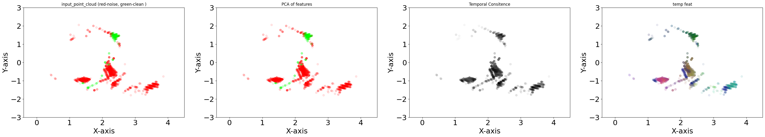
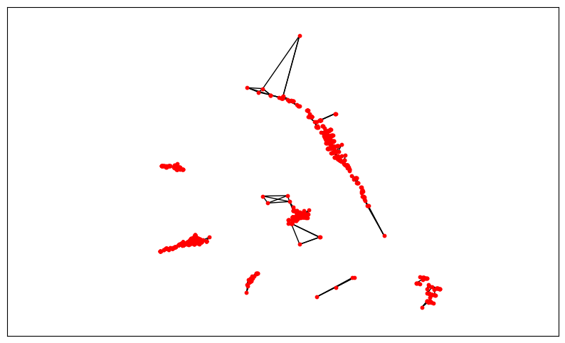
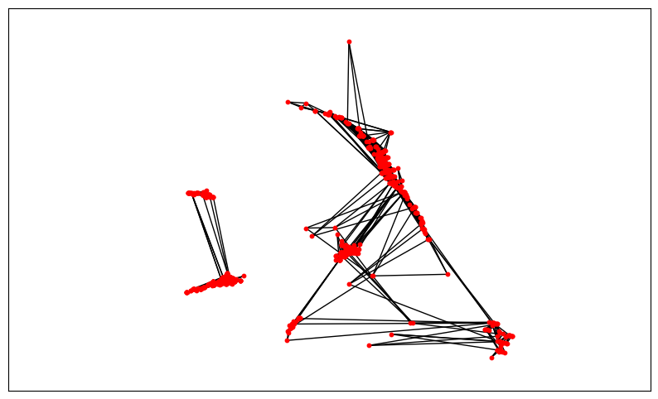
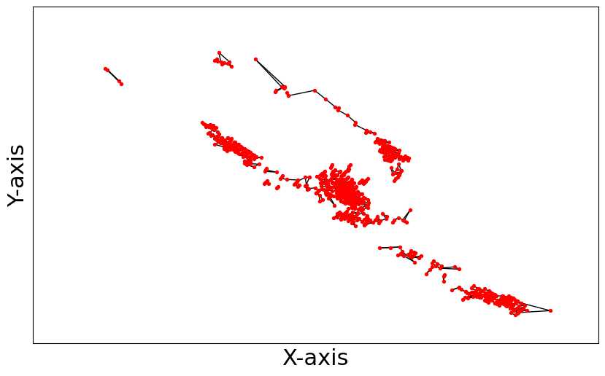
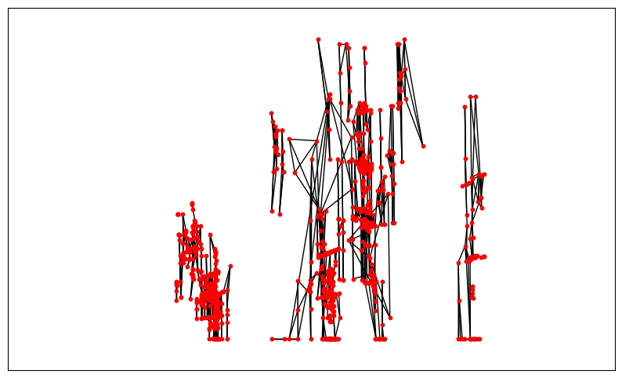
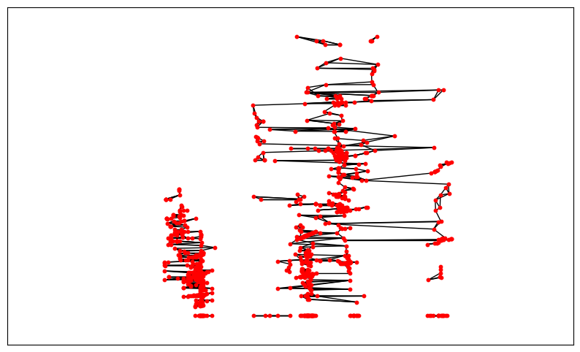
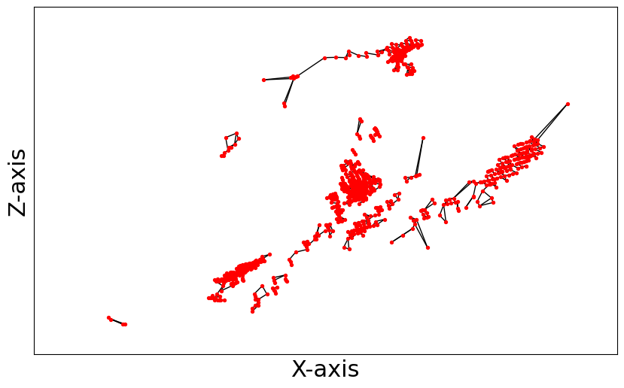
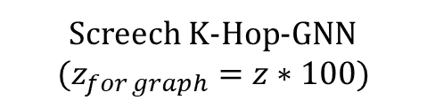
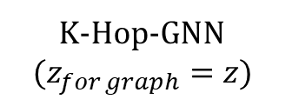
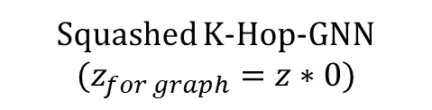
K-Hop-GNN
$$(z_{for graph}=z)$$
Screech K-Hop-GNN
$$(z_{for graph}=z∗100)$$
Squashed K-Hop-GNN
$$(z_{for graph}=z∗0)$$
XY View
Y
Y
XZ View
Z
X

Slide 2
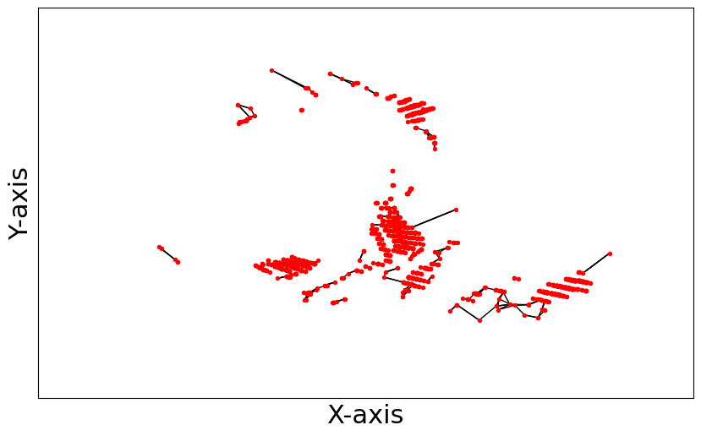
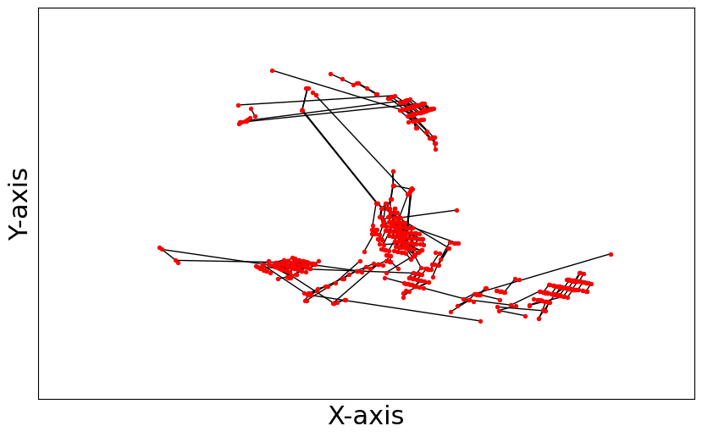

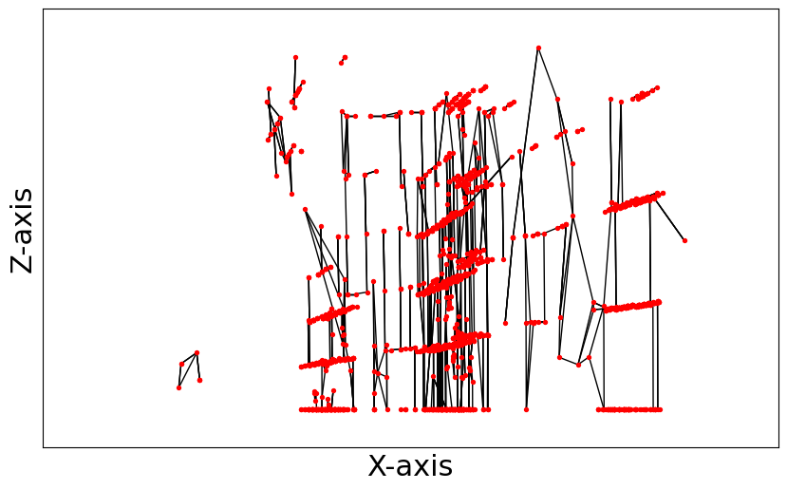
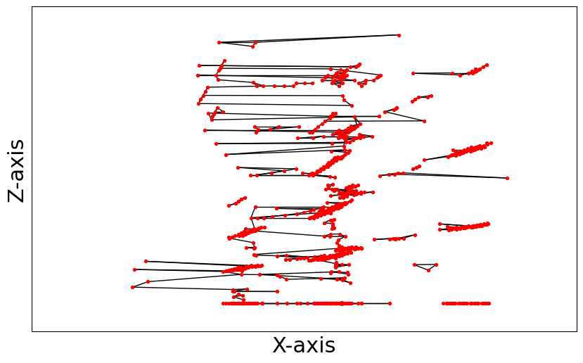
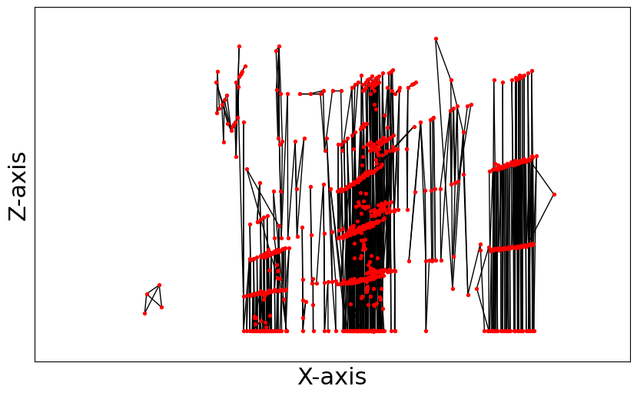
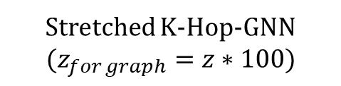
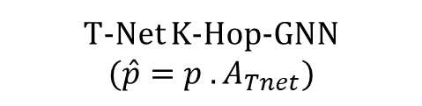
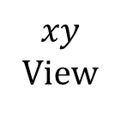
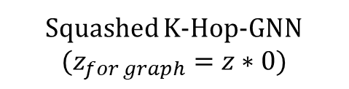
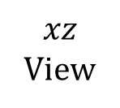
K-Hop-GNN
Stretched K-Hop-GNN
$$(z_{for graph}=z∗100)$$
Squashed K-Hop-GNN
$$(z_{for graph}=z∗0)$$
T-Net K-Hop-GNN
$$(\hat{p}=p . A_{Tnet})$$
$$xy$$
View
$$xz$$
View

Slide 3
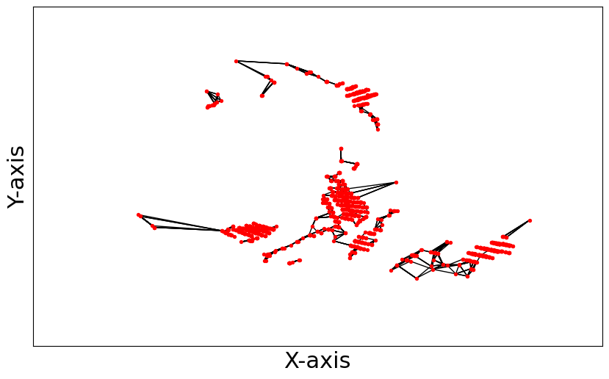
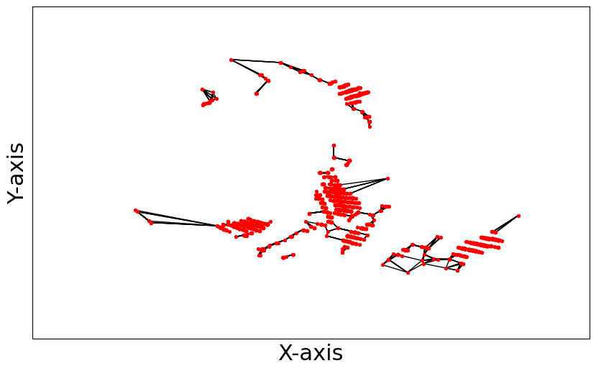
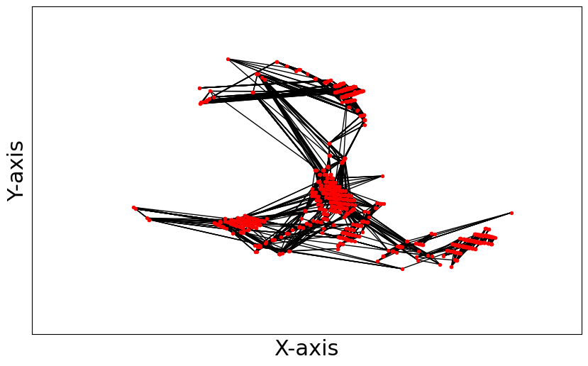
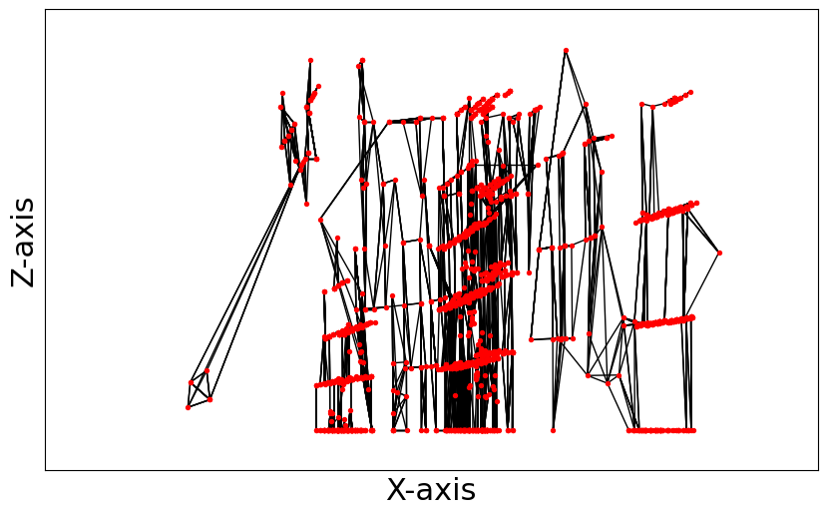
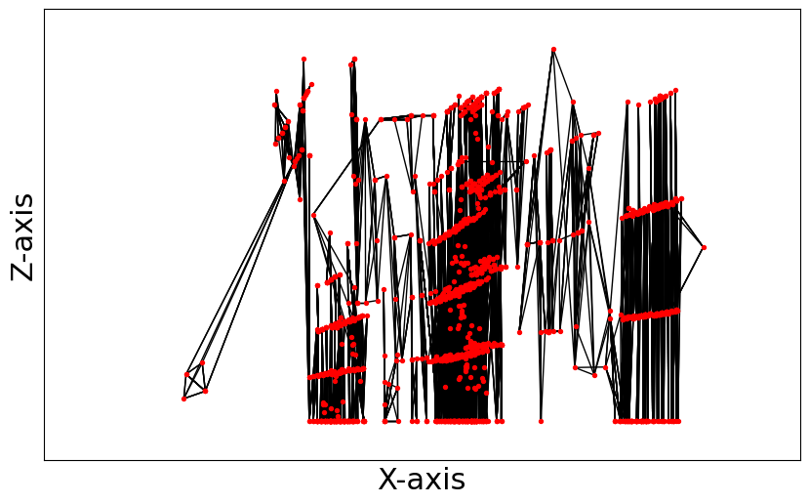
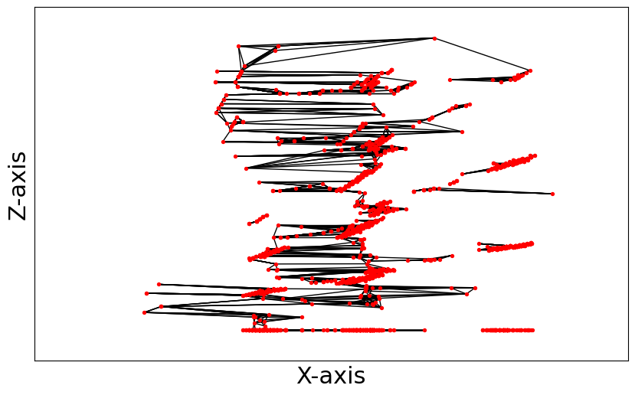

Slide 4
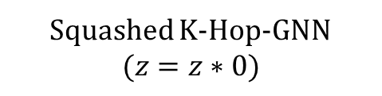
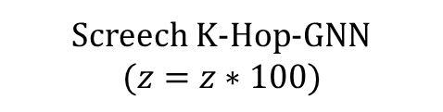
Screech K-Hop-GNN
$$(z=z∗100)$$
Squashed K-Hop-GNN
$$(z=z∗0)$$
K-Hop-GNN
Y
Y
Z
X

Slide 5
Temporal-Consistency (TC) module
Consistent point
Sporadic point
Temporal-Consistency (TC) module
t -1
t
t +1
Consistent point
Sporadic point
t -1
t
t +1

Slide 6
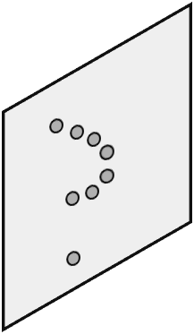
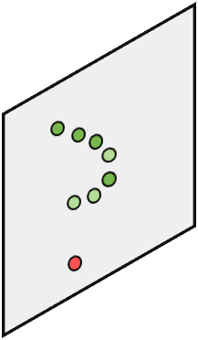
Temporal-Consistency (TC) module
Consistent point
Sporadic point
t -1
t
t +1
E.g, K-Hop-GNN
Temporal Con z

Slide 7
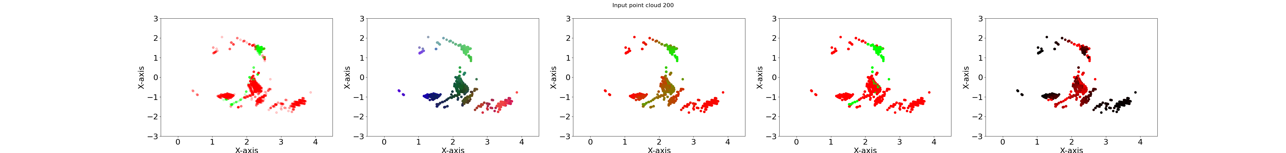
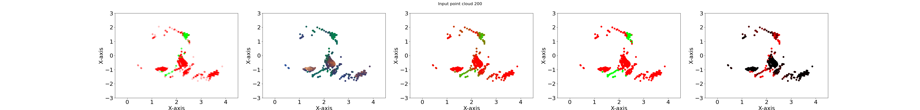

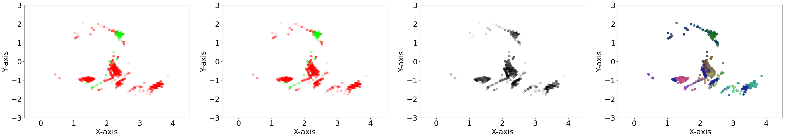
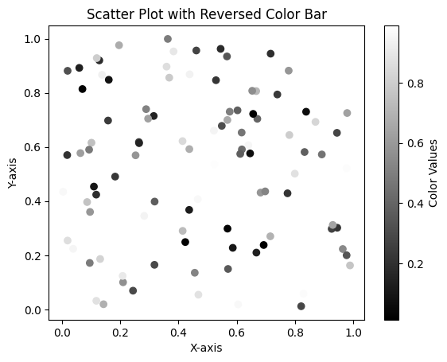
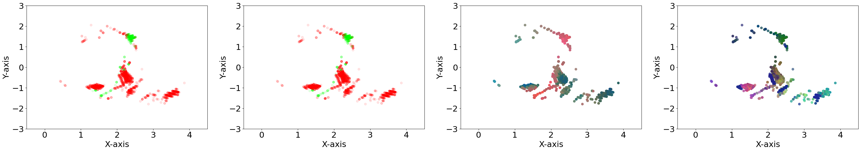
Features PCA of PointNet
Features PCA of K-Hop-GNN
Features PCA of Graph-Transformer
Pseudo temporal consistency
consistent
point
Features PCA at the TC layer
Features PCA at the K-Hop-GNN layer
sporadic
point

Slide 8
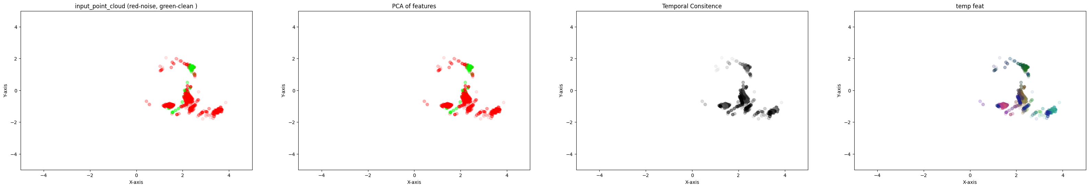


Slide 9
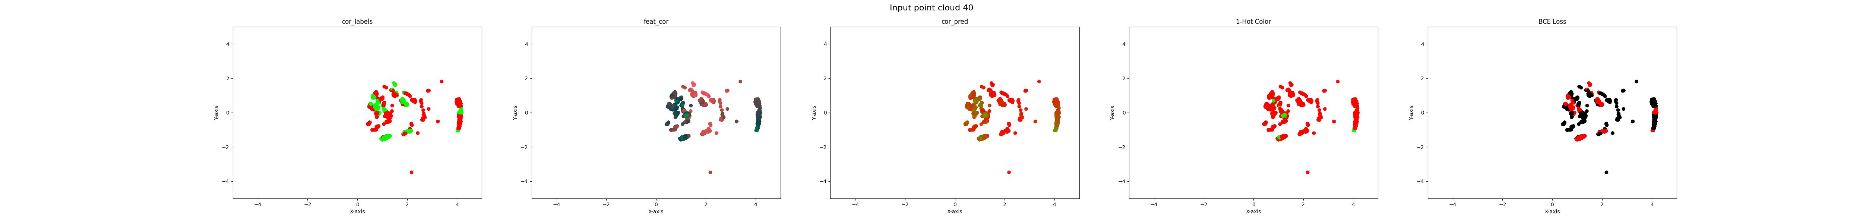
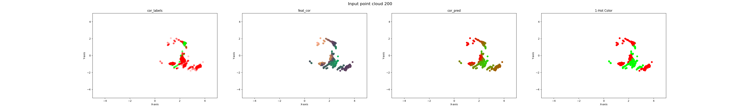
Why does PointNet and DGCNN fail?

Slide 10
PCA K-Hop-GNN layer features
Pseudo temporal consistency
consistent
point
Features PCA at the TC layer
Features PCA at the K-Hop-GNN layer
sporadic
point

Slide 11

Manual temporal consistency
Features PCA at the TC module
consistent
point
sporadic
point

Slide 12
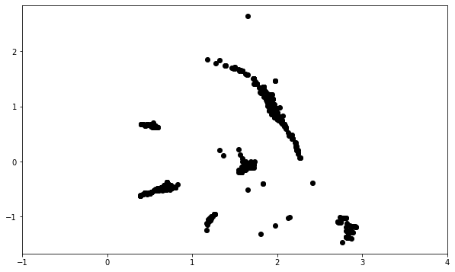
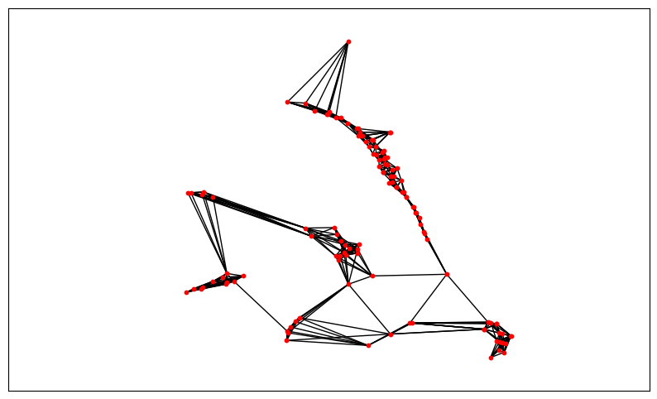
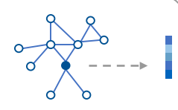
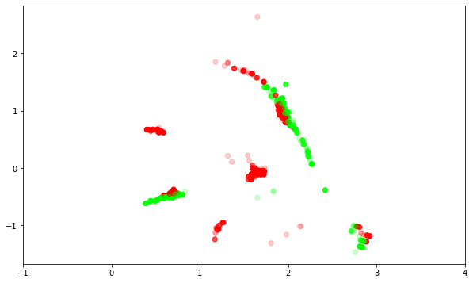
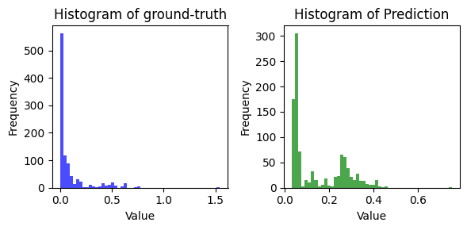
Data Preparation
Graph Construction
GNN
Denoised Data

Slide 13
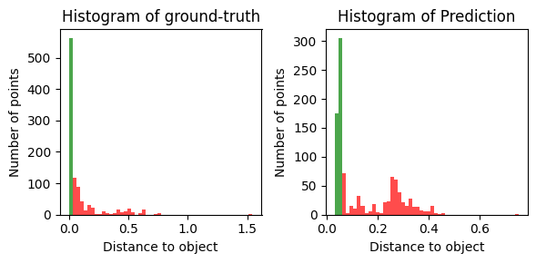
Noise points
Noise points
True points
True points

Slide 14
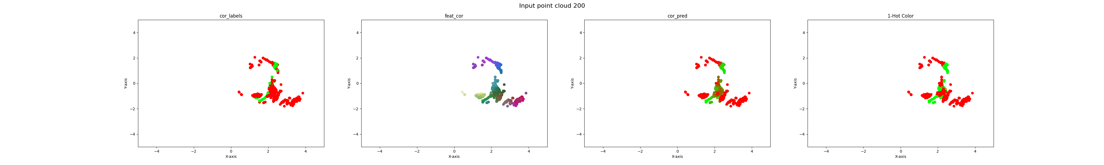
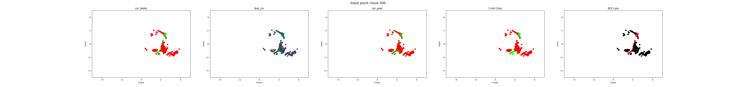
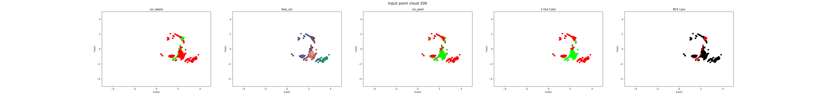
Graph-Transformer
PointNet
K-Hop GNN

Slide 17
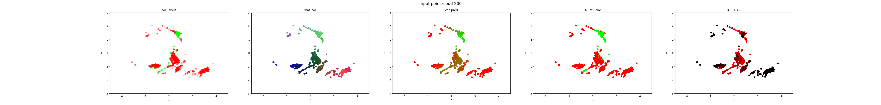
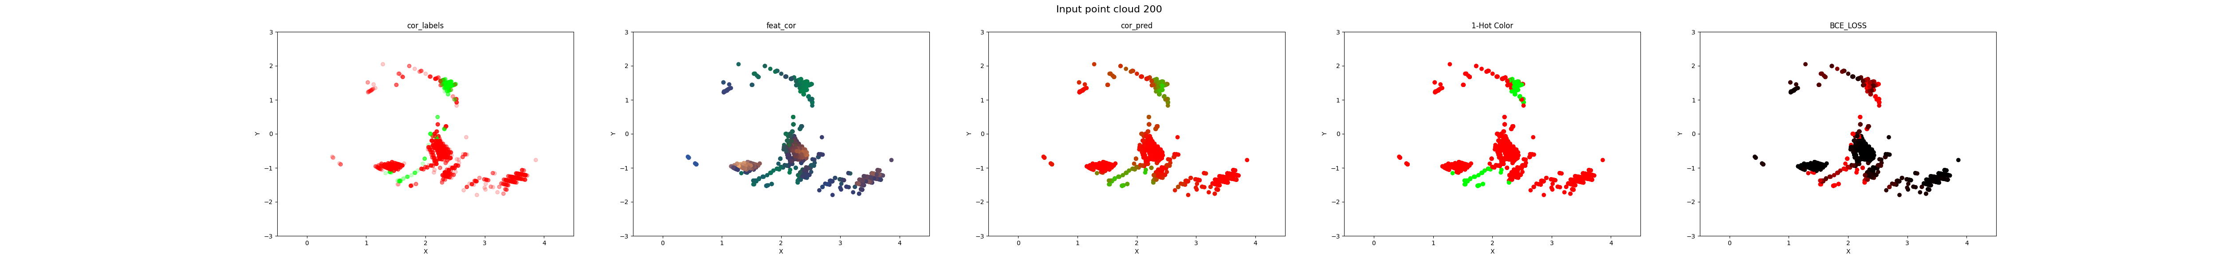
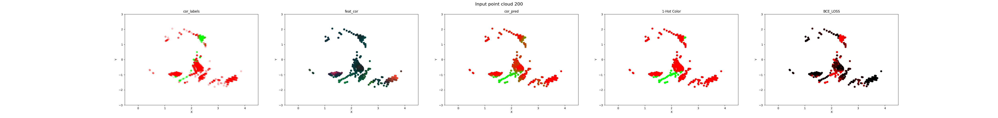


Ground-truth
Features PCA
Prediction
1-Hot Prediction
BCE Error
PointNet
K-Hop GNN
Graph-Transformer MSG-GNN
TC
K-Hop GNN
TC
Graph-Transformer MSG-GNN

Slide 18

Ground-truth
(Sequence Room 200)
Ground-truth
(Sequence Room 500)
Prediction
BCE Error
PointNet
K-Hop GNN
Graph-Transformer MSG-GNN
TC
K-Hop GNN
TC
Graph-Transformer MSG-GNN

Slide 19




Sequence 200
Sequence 500
True point
True point
Ground-truth
Noise point
Noise point
Prediction
Prediction Error
Prediction
Prediction Error
PointNet
K-Hop GNN
Graph-Transformer MSG-GNN
TC
K-Hop GNN
TC
Graph-Transformer MSG-GNN

Slide 20


Slide 21


Slide 22





200
PointNet
V11 _r0
K-Hop v11_lr3_r0

Slide 23




Slide 24

TCGraph Transformer
PointNet
K-Hop GNN
Graph Transformer
Ground-truth point cloud

Slide 25


